Slide 1
Relationships within triangles
Geometry Unit 5

Slide 2
Midsegments of a triangle

Slide 3
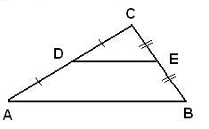
What is a midsegment?
A midsegment connects the midpoints of two segments of a triangle.
Given diagram below:

Slide 4
Construction of a midpoint
http://www.mathsisfun.com/geometry/constructions.html

Slide 5
Observations
What do you notice about the midsegments you created?
Lengths?
Lines?
Parallels?
Perpendiculars?
Intersections?

Slide 6
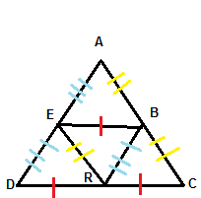
Properties of midsegements
Midsegment Theorem:
The segment that joins the midpoints of a pair of sides of a triangle is:
Parallel to the third side
Half as long as the third side

Slide 8
Usefulness
When would you use the midpoints of a triangle?
When trying to determine relationships within a triangle.
When trying to solve for a variable or a length
Application problems when needing to cut across the center and find the distance.

Slide 9
Perpendicular bisectors in a triangle

Slide 10
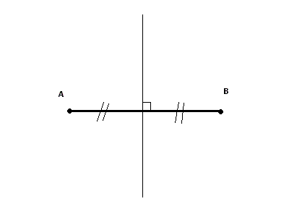
What is a perpendicular Bisector?
Perpendicular bisectors:
Divide the line segment into two congruent parts
Intersects the line at a right angle

Slide 11
Construction of a Perpendicular Bisector
http://www.mathsisfun.com/geometry/constructions.html

Slide 12
Perpendicular bisectors
What do you notice about the perpendicular bisectors of the triangles?
Lengths?
Lines?
Parallels?
Perpendiculars?
Intersections?

Slide 13
Practice
On triangles three and four on your worksheet create the perpendicular bisectors for the triangles.

Slide 14
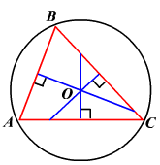
Circumcenter
The point of concurrency of the three perpendicular bisectors of the sides of a triangle.
This point will be equidistant from each vertex.

Slide 15
Circumcenter
What will the circumcenter look like in the following triangles?
Acute?
Right?
Obtuse?
How do you know? Do these findings make sense?

Slide 16
Angle bisectors in triangles

Slide 17
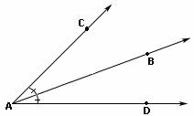
What Is an angle bisector?
An angle bisector is a ray or segment which cuts an angle into two congruent angles.

Slide 18
Construction of an angle bisector
http://www.mathsisfun.com/geometry/constructions.html

Slide 19
Observations
What do you notice about the angle bisectors of the triangles?
Lengths?
Lines?
Parallels?
Perpendiculars?
Intersections?

Slide 20
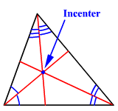
incenter
The incenter is the point of concurrency of all three angle bisectors of a triangle.
The incenter is equidistant from all the edges of the triangle.

Slide 21
incenter
What will the incenter look like in each of the following triangles?
Acute?
Right?
Obtuse?
How do you know?

Slide 22
Medians in triangles

Slide 23
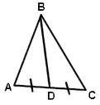
What is a median?
A median of a triangle is the line segment which joins a vertex to the midpoint of the opposite side.

Slide 24
Construction of a Median
How could you use your compass and protractor to create a median of a triangle?
Lets practice on one of the triangles on your paper.

Slide 25
Observations
Do the three medians meet in a point?
YES! We call this the centroid of the triangle.
What do we notice about the centroid of the triangle?
Lengths?
Angles?
Segments?

Slide 26
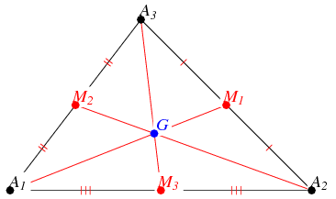
Concurrency of medians theorem
States the medians of a triangle will intersect in a point that is 2/3 the distance from the vertices to the midpoint of the opposite side.

Slide 27
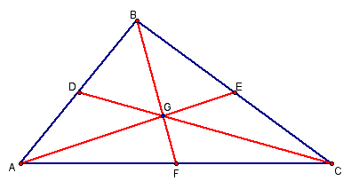
Concurrency of medians of a triangle

Slide 28
Altitudes in triangles

Slide 29
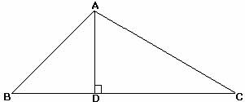
What is an altitude?
The line segment from a vertex perpendicular to the opposite side.

Slide 30
Construction of an Altitude
Can I construct the altitude of a triangle?
How!!!!!!?????
http://www.mathsisfun.com/geometry/construct-perpnotline.html

Slide 31
Lets try!!!
Lets create the altitudes of the three angles in one of the triangles on your page.
What do you notice about the altitudes?

Slide 32
Orthocenter
The point of concurrency of the altitudes of a triangle is called the orthocenter.
What do you notice about the orthocenter of the following triangles:
Acute
Obtuse
Right

Slide 33
Observations

Slide 34
Constructions
On your triangle page, find the following for a single triangle. You may want to erase your marks after each.
Circumcenter
Incenter
Centroid
Orthocenter

Slide 35
Group Work
After you have completed each of the constructions and have them clearly labeled.
Note all the similarities you can about these

Slide 36
Similarities
Acute triangle- all points are inside the triangle
Obtuse triangle- all points are outside the triangle
Right triangle- orthocenter on vertex of right angle, circumcenter is on the midpoint of the hypotenuse

Slide 37
Similarities
For the general case of a triangle:
The orthocenter, circumcenter, and centroid are always collinear
The distance from the orthocenter to the centroid is twice the distance from the centroid to the circumcenter.

Slide 38
Review
Perpendicular bisectors meet at the circumcenter.
Angle bisectors meet at the incenter.
Medians meet at the centroid.
Altitudes meet at the orthocenter.

Slide 39
Inequalities in triangles

Slide 40
Inequalities in two triangles

