Slide 1
Unit 2: Banking

Slide 2
Why do you need a bank?

Slide 3
Purpose of Banks
What are some purposes of Banks?
Loans
Depository
Manage money
Credit

Slide 4
Bank or Credit Union
Bank
Customers
For Profit
Credit union
Members
Not for Profit
Both
May have an application process
Banks:
Location
Income
Credit Score
Credit Unions:
Employer
Associations
Affiliations

Slide 5
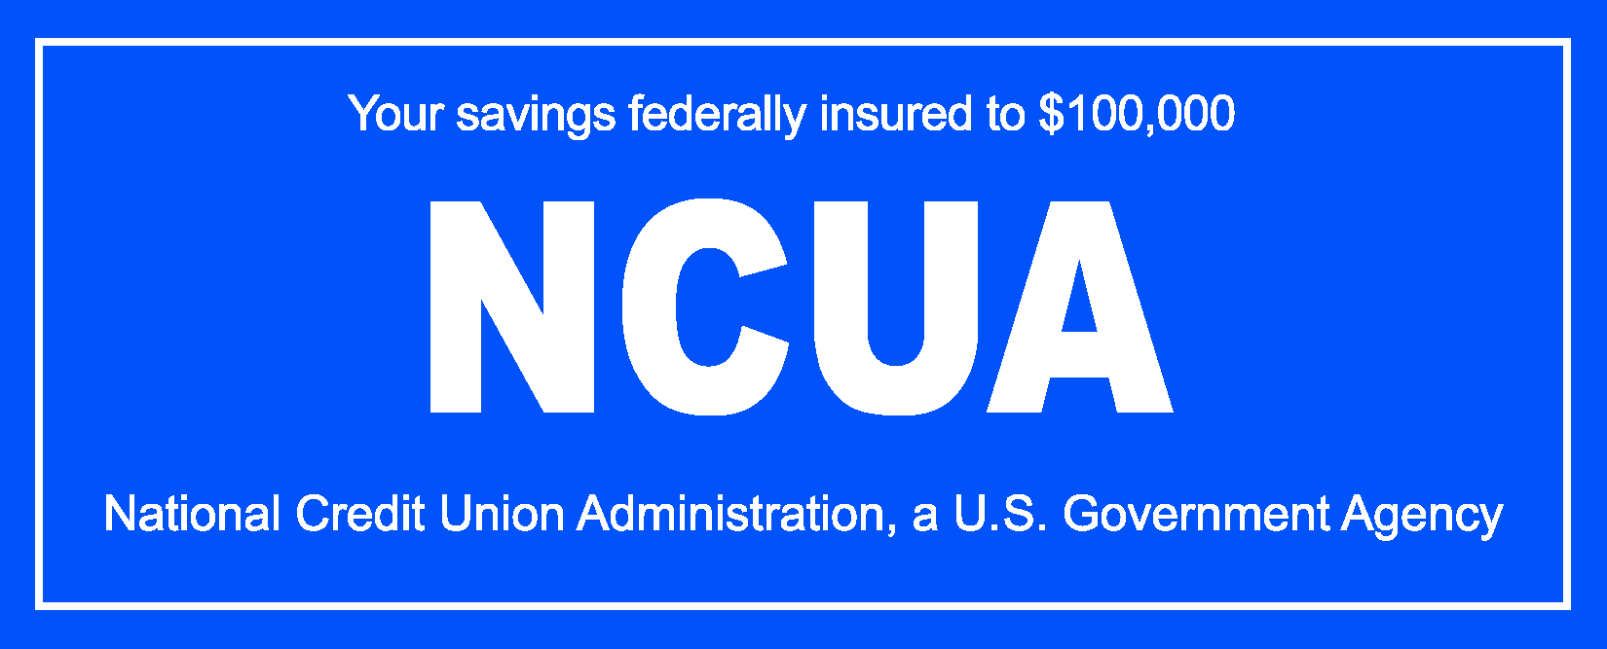
Safety of Financial Institutions
Both banks and credit unions insure deposits up to $100,000 per depositor per institution.
FDIC: Federal deposit insurance corporation
NCUA: National Credit union administration

Slide 6
Services of a bank

Slide 7
Overview
Bank employees
Financial services
Services for personal benefit
What others?

Slide 8
Bank occupations
Tellers
Platform bankers
Mortgage lenders
Operations manager
Branch manager
What do they do?

Slide 9
Financial services
What financial services do banks/ credit unions provide?
Brainstorm as many as possible!

Slide 10
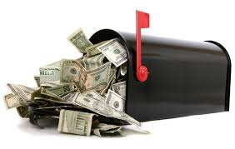
Sending and receiving money
Money transfer organizations
Bank transfers
Hand delivery
Mail
Hawala
Post offices
Stored value cards

Slide 11
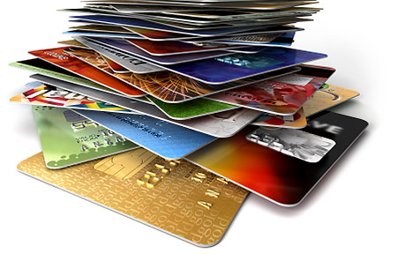
Electronic Services
Online banking
Direct Deposit
Transfers between accounts
Transfers to a third party
Bank by phone
ATM

Slide 12
Bank Card Types
Check cards/ debit Cards
Stored Value Cards
Credit Cards
Research-- What is the difference between each?

Slide 13
Checking Accounts

Slide 14
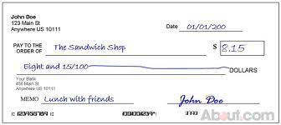
What is a check?
A check is a written order telling the bank to pay a certain amount To another person or business.

Slide 15
Overview
Purposes of a checking account
Terminology/terms of a checking account
Shopping for a checking account
Using a checking account

Slide 16
Purposes
What are some of the purposes people have checking accounts?
List them here:

Slide 17
Terminology
Bank Statement: Monthly record of all activity within an account, provided by the bank.
Cancelled Check: A check that has been stamped to show that the payee has received the designated amount from the bank and that amount has been deducted from the account holder’s checking account.
Check: A written order to pay a specified sum from funds held in a bank or credit union account.
Check Register/Ledger: A record of all activity that happens within a checking
account; maintained by the checking account holder.
Endorsement: A written mark on the back of a check, such as a signature, entitling the payee to either receive or transfer payment.
Fee: Charges for the use of certain bank services. These services vary but could include returning cancelled checks, writing more than a certain number of checks monthly, use of various bank cards, etc.
Interest: Money paid to savers and investors by financial institutions, government, or business entities for the use of their money.

Slide 18
Terminology
Interest: Money paid to savers and investors by financial institutions, government, or business entities for the use of their money.
Minimum Balance: Requirement to keep a certain amount of money in the account; otherwise, monthly service charges may result.
Outstanding Transactions: Transactions that do not clear the bank by the date of the bank statement.
Overdraft: Lack of sufficient funds in a checking account to cover the full amount of a check. A bank or credit union will charge an Overdraft Fee — a service charge — to cover expenses involved in returning a check and handling other procedures caused by an overdraft.
Overdraft Protection: Procedure agreed upon by an account holder and a bank in
advance to transfer funds from a savings or credit account to a checking account to cover insufficient funds.
Payee: The person or organization to whom a check is made payable.
Reconciling a Bank Statement: Balancing a bank statement with a check register/ledger.
Transaction Limits: Some accounts have a limit on the number of transactions
performed during a certain time period. These may include the number of withdrawals, number of teller-assisted activities, etc.

Slide 19
Opening an account
Processes vary from bank to bank.
Need important information such as name, social security number, phone number, address, and Identification
Acceptable forms of Identification on next slide
Make sure information is accurate and written clearly!
Many will open an account the same day as you apply

Slide 20
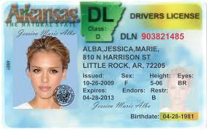
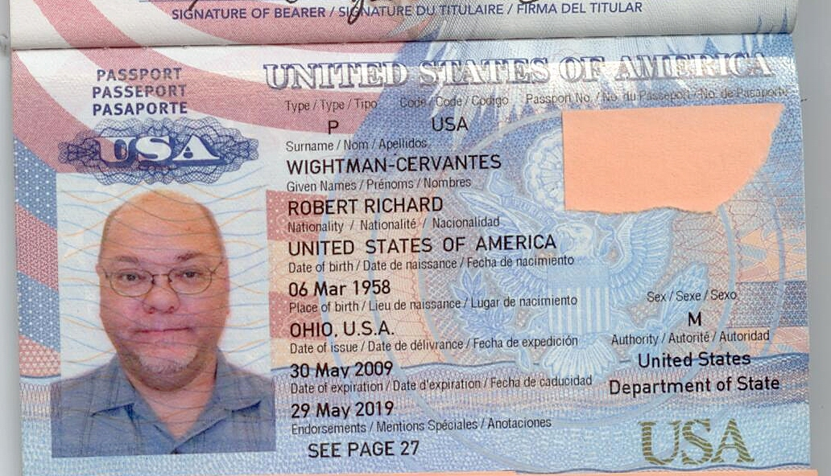
Primary Sources of ID
Primary ID*
Photo Driver’s License issued within the U.S. or Canada
State Non-Driver Photo ID
Photo Learner’s Permit
Government Photo ID
U.S. Passport
Non-U.S. Passport
Resident Registration Card
Mexican Consular ID (Matricula Consular)
Naturalization Certificate
Employee Photo ID (from a recognizable employer)
Photo Trade License (barber, plumber, electrician, etc.)
Student Photo ID (college/trade school)
Medicare Card (must be 65 or older)
* Financial institutions' ID requirements may differ; check with the institution first before applying for an account.
Notes:
A major topic to emphasize is proper identification. Although acceptable identification may vary among financial institutions, it always includes as least two types of current government-issued identification.
• Such regular identification might include a driver’s license, military ID,
passport, green card, etc. In some states, a Mexican consulate card is
an acceptable form of identification to open a bank account.
Review this slide and emphasize that this is a list of commonly accepted forms of primary ID, and that secondary ID is required (reviewed on next slide).

Slide 21
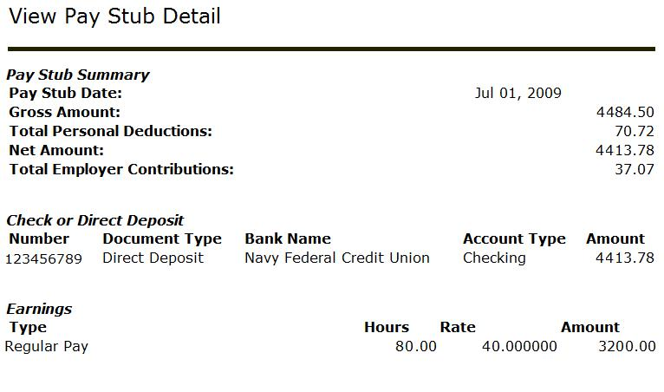
Secondary Sources of ID
Secondary ID*
Foreign Driver’s License
State/Local Gun Permit
Utility Bill (Name and address of individual account should be listed)
Current Bank Statement
National Credit Card
Bank-issued Debit or Check Card
Pay Stub
Car Registration
Mortgage Statement
Letter of Introduction from Bank, Embassy, or well-known Employer
Welfare Card
Supplemental Health Insurance Card
* Financial institutions' ID requirements may differ; check with the institution first before applying for an account.
21
Notes:
•Review this list of commonly accepted forms of secondary ID.
Taxpayer Identification Numbers (TIN): Social Security Numbers can
be used to open basic bank and credit accounts, while Individual
Taxpayer Identification Numbers (ITIN) may be used to open noncredit
accounts. Talk with your local bank or credit union about these
requirements.
• Be prepared. Call ahead to find out exactly what you will need to
open an account and what hours the bank is open.

Slide 22
SERVICES
Location of bank
Location of ATMs
Banking hours
Minimum balance required
Minimum transactions or limits
Interest-bearing accounts?
Other
COSTS
Non-primary bank ATM transactions
In-branch transaction fees
Per-check fees
Other checking fees
Overdraft protection
Printing of checks
SHOPPING
AROUND
(THINGS TO ASK ABOUT WHEN
OPENING A CHECKING ACCOUNT)
22
Notes:
Ask if anyone looked for any special type of checking account when they opened their account. Record the responses. Responses will vary.
Help participants determine their banking needs by asking them to think about:
• How many checks they write monthly.
• Their typical checking account balance.
• What is convenient for them in terms of bank and ATM locations, hours, etc.
• What kind of accounts they want (non-interest vs. interest-bearing)
Use “Slide 2: Shopping Around” (Things to Ask About When Opening a Checking Account) to encourage participants to shop around for the checking account that fits their needs.
• Explain to participants the importance of shopping for a checking account. Go over some of the key features (Examples: the location, hours of operation, minimum balance required, etc.) that participants should compare before choosing a checking account. Tell participants to use slide 2 as a tool to help them evaluate the features of different checking accounts.
• Stress the value of key areas, especially if participants were looking for non-financial items such as color or style of checks.
• Remind participants that certain account features will help them save money. Some of the features to help participants save money and avoid bank fees include: 1) utilizing direct deposit to avoid check cashing fees; 2) avoiding non-primary ATM charges; and 3) keeping the minimum monthly account balance to avoid monthly maintenance fees.
• After the discussion, refer to the earlier responses about what participants looked for in a checking account.

Slide 23
Spending Money
What are the multiple ways to spend money out of your account?
Check
Debit Card
ATM
Any others?

Slide 24
Writing A Check

Slide 25
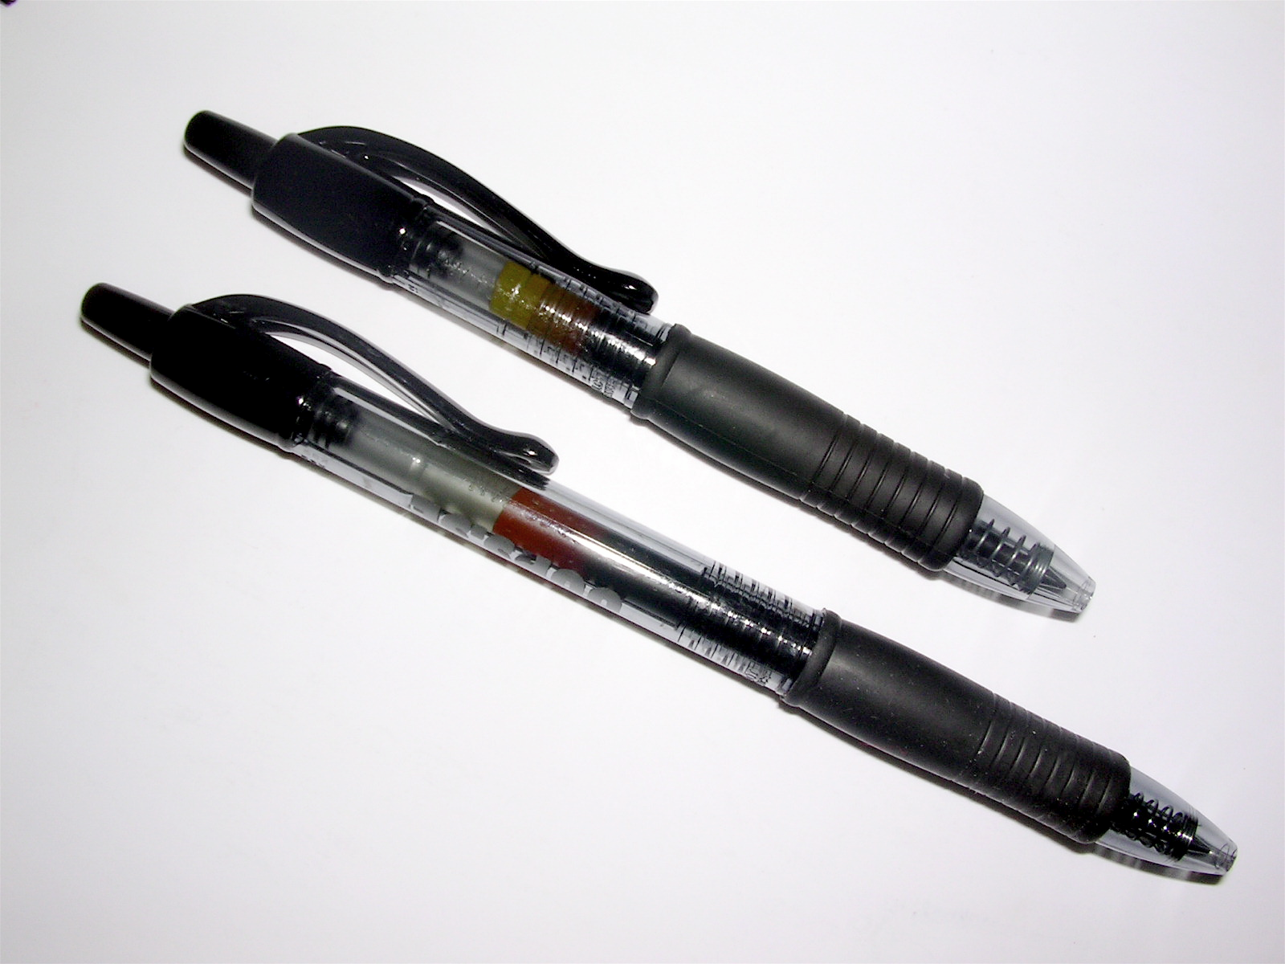
Writing a check
Checks should always be written in Ink!!!
If you mess up writing a check make sure to void the check by writing void across the check and tearing it up and throwing it away.

Slide 26
Writing a check
Parts of a check:
Date
Payee
Amount in numbers
Amount in words
Signature
Memo
Routing number
Account number
Check number
Transit number

Slide 27
Practice
Practice writing a check
Write the first check to Caseys General Store for $50.00 for gas.
Write the second check to Wal-Mart for $142.25 for groceries.
Write the third check to Dunkerton hs for $68.00 for a yearbook

Slide 28
Maintaining a checking account
Keeping a check register
Making a deposit
Reconciling a bank statement
Maintaining a checking account
Avoiding overdraft fees

Slide 29
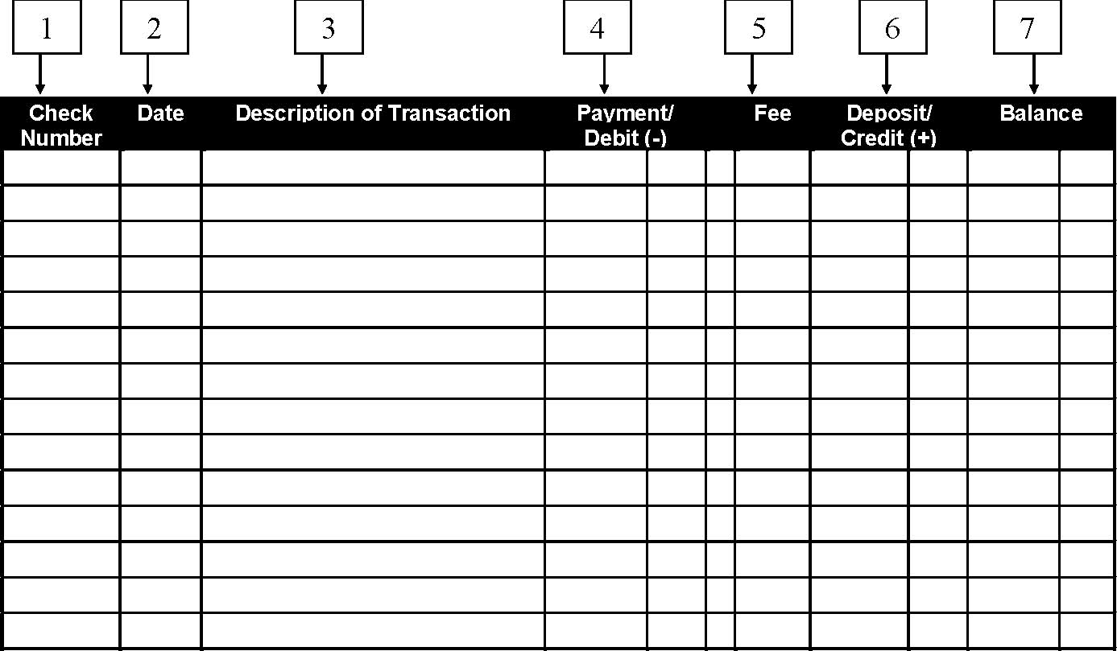
Check register

Slide 30
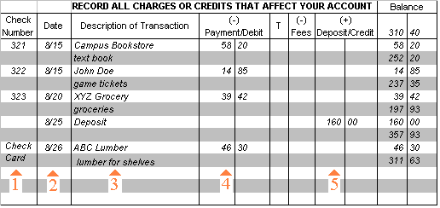
Check register

Slide 31
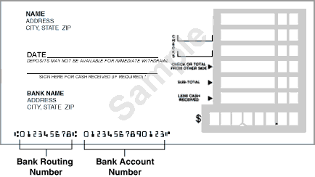
Making a deposit
Deposits are credits
Endorsing Checks
Made either electronically
or in person
Fill out a deposit ticket

Slide 32
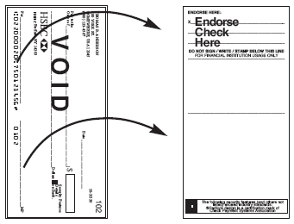
Endorsing checks
Three main ways to endorse a check
Sign the back
Pay to the order of:
For deposit only
Which is the most restrictive?

Slide 33
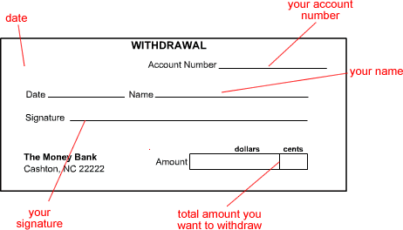
Making a withdrawal

Slide 34
Reconciling a bank statement
Means checking to make sure the bank statement matches your check register
Check for errors
Check for any missing withdraws or any missing deposits
Check for accuracy

Slide 35
Maintaining a checking account
Check bank statements and balances often
Re-order checks as needed (Make sure to get routing and bank numbers correct)
Keep a minimum balance if required
Avoid overdraft fees (Don’t spend more than you have in your account)
Common overdraft fee is $25- $40 per transaction

Slide 36
Checking account practice
Project handout
One class period to work on it
Worth 50 points

Slide 37
Savings accounts

Slide 38
Overview
Purpose of a savings account
Shopping for a savings account
Applying for a savings account
Monthly statements

Slide 39
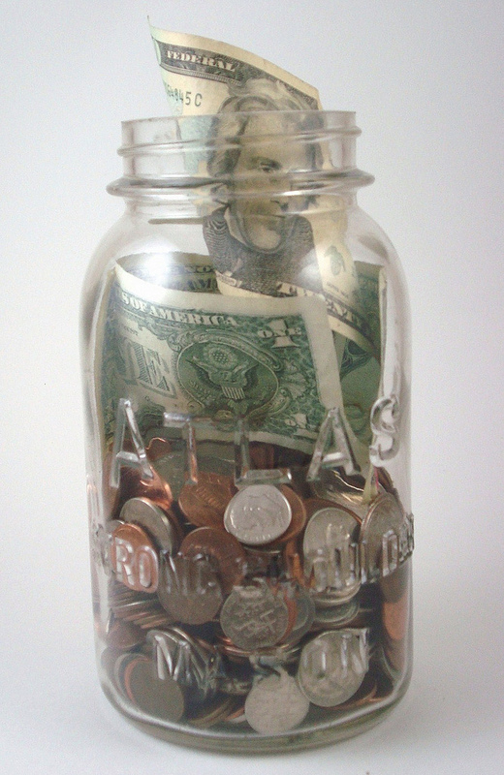
Purpose
SAVING!!!!
Reasons to save:
Emergencies
Future Purchases
Future investments

Slide 40
Shopping for a savings account
What to look for in a savings account:
Safety
Minimum balance
Fees and service charges
Interest rate
Returns
Compounding
Automatic transfers
Direct Deposits

Slide 41
Opening a savings account
Basically the Same as opening a checking account
Many youth savings yield higher interest rates
Need two forms of Identification

Slide 42
Monthly statements
Record and document deposits and withdrawals
Check that you are always above the minimum balance
Make sure you are getting your interest

Slide 43
Shopping for a Bank
You need to research banks in the area and determine which bank you are going to open an account with.
Refer to handout!
What were the most important attributes you utilized to choose a bank?

