Slide 1
Exponential Equations
Algebra 2 Unit 2: Exponential and Logarithmic equations

Slide 2
M&M Activity
Follow the directions given in the M&M packet. I should not have to walk you through the directions as they are written out for you to READ!!!!

Slide 3
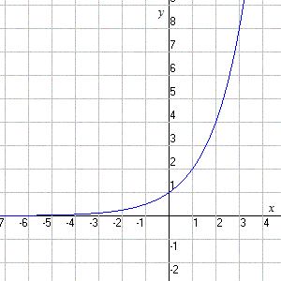
Parent Function
$y=ab^{x}$

Slide 4
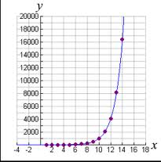
Exponential Growth
The value of b is larger than 1.
The graph grows from left to right.
As x gets larger, y gets larger.
An example is to the right.

Slide 5
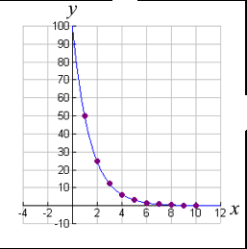
Exponential Decay
The value of b is between 0 and 1
It is a fraction.
The graph falls from left to right.
As x gets larger, y gets smaller.
An example is to the right.

Slide 6
Determining Exponential Equations
Parent Function of an Exponential Function:
$y=ab^{x}$
Use two ordered pairs to substitute for x and y. (You will want to use (0,y) and (x, y) points.)
It would also be a good idea to use the smallest and largest values you are given to create the most accurate function.

Slide 7
Determining Exponential Equations
Replace x and y into the equation. The first equation with (0, y) will give you the a value to substitute into the second equation.
If your points were (0, 3) and (7, 139)
3 = a b° and 139 = a b⁷

Slide 8
Determining Exponential Equations
Given your two equations, solve.
3 = a b° and 139 = a b⁷
3 = a * 1 and 139 = a b⁷
3 = a and 139 = 3 b⁷
46.33 = b⁷
(46.33)^(1/7) = b

Slide 9
Determining Exponential Equations
Once you have found a and b, plug them into the parent function to find your actual function.
A = 3 ; b = 1.73
SO……… y = 3*1.73ᵡ

Slide 10
Creating an exponential model
Given the two points, determine if the function is showing exponential growth or decay, then given the function.
(0, 12) and (4, 129)
(1, 999) and ( 9, 14)

Slide 11
Exponential Models
Other forms of the equation and their situations
A=Peͬͭͬͬͬͬͬͭ where
A = amount after a given time, P = initial amount, r = rate of growth or decay and t = time.
Used in calculations of interest, bacteria growth, etc.

Slide 12
To Plot in your graphing calculator

Slide 13
Graphing calculators
To enter data points:
STAT → EDIT → 1: Edit → Enter
Enter x values into L1, enter y values into L2.

Slide 14
Graphing calculators
To look at the scatter plot:
2nd → Y= → 1: Plot 1→ Enter→ On→ Enter →2nd→QUIT
GRAPH

Slide 15
Graphing calculators
To find the exponential equation:
STAT → CALC → 0: EXPREG →Enter → Enter

Slide 16
Real life Examples

Slide 17
Solve
A biologist is researching a newly-discovered species of bacteria. At time t = 0 hours, he puts one hundred bacteria into what he has determined to be a favorable growth medium. Six hours later, he measures 450 bacteria. Assuming exponential growth:
Determine a function for the data
Determine the number of bacteria after 10 hours.

Slide 18
Solve
Each year the local country club sponsors a tennis tournament. Play starts with 128 participants and each round, half of the players are eliminated. How many players remain after 5 rounds?

Slide 19
Solve
You have inherited land that was purchased for $30,000 in 1960. The value of the land increased approximately 5% per year. What is the approximate value of the land in the year 2011?

Slide 20
Solve
An adult takes 400 mg of ibuprofen. Each hour the amount of ibuprofen in the person’s system decreases by about 29%. How much ibuprofen is left after 6 hours?

Slide 21
Compound interest

Slide 22
Compound interest
If I say that I receive 5% interest, how do I change that to a decimal for multiplication?

Slide 23
Compound interest
There are different types of compounding depending on the bank.
Annually (yearly) – 1 time
Semi-Annually – 2 times
Quarterly – 4 times
Monthly – 12 times
Daily – 365 times

Slide 24
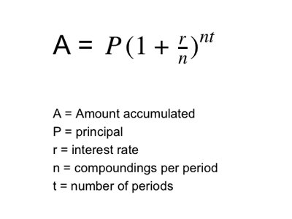
Compound interest

Slide 25
Compound interest
If I deposit $1600 in a bank account and the account pays 2.5% annual interest compounded monthly, how much would be in the account after 3 years?

Slide 26
Compound interest
If I deposit $1600 in a bank account and the account pays 2.5% annual interest compounded daily, how much would be in the account after 3 years?

Slide 27
Compound interest
Which of the previous questions earned you more money?

