Slide 1
Graphing Systems of Equations
Algebra 1: Unit 7

Slide 2
Graphing linear equations

Slide 3
Graphing Linear Equations
The steps to graphing a linear equation:
Step 1: Create an x/y chart
Step 2: Pick two points for x
Step 3: Determine the value of y given x
Step 4: Graph the two points and draw the line.

Slide 4

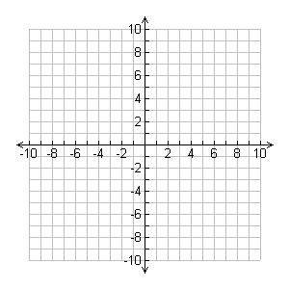
Example
X
Y
Graph the equation: y = 3x - 1
  Step 1: Create an x/y chart
  Step 2: Pick two points for x
  Step 3: Determine the value of y given x
  Step 4: Graph the two points and draw the line.
0
-1
1
2

Slide 5
Graphing Linear Systems of Equations

Slide 6
What is a linear system?
A linear system is two or more equations.
  Linear systems are graphed on the same coordinate plane.
What is the importance of linear systems?
  What do you think you could find by graphing both equations on the same plane?

Slide 7
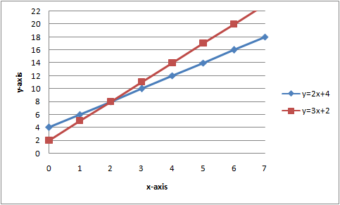
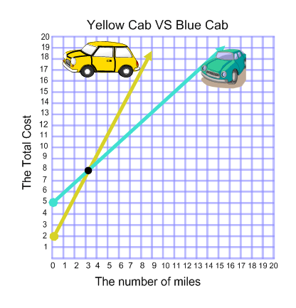
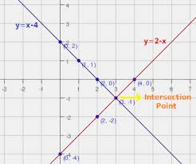
Graphic Examples

Slide 8
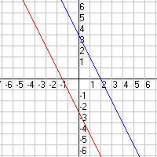
What if the lines don’t intersect?
What happens if the two lines we are graphing do not intersect?
  What do we call these lines?
  Will there be an answer for this specific problem?

Slide 9
Word Examples
Anytime you need to find the intersection of two linear lines:
  When will two people meet if traveling at different speeds.
  What is the cost of an item if you know how many you bought and the total price.

Slide 10
example

Slide 11
example

Slide 12
Practice

Slide 13
Individually graph these systems
On a sheet of graph paper, graph each of these systems of equations. Make sure to note the point of intersection of the two lines.

Slide 14
Individually graph these systems
On a sheet of graph paper, graph each of these systems of equations. Make sure to note the point of intersection of the two lines.

Slide 15
Calculator Rules for Equations
To enter equations:
  Press Y= and enter the equations into y1 and y2
To graph:
  Press GRAPH
To find the intersection point:
  Press 2nd → TRACE. Go down to intersect.
  Press ENTER, ENTER, then move the flashing dot to the intersection point and press ENTER.

Slide 16
Calculator Rules for inequalities
To enter equations:
  Press Y= and enter the equations into y1 and y2
  Note the way the inequalities are:
    >, ≥ will have shading on top (change on the left side of the screen)
    <, ≤ will have shading on bottom (change on the left side of the screen)
To graph:
  Press GRAPH

