Slide 1
Logarithmic Functions
Algebra 2 Unit 2: Exponential and Logarithmic Functions

Slide 2
When do you use Logarithms?
Decibels
Richter Scale
Carbon Dating
pH levels
Converting Exponents

Slide 3
Introducing Logarithms
A logarithm answers the question:
How many of one number do we multiply to get another number?
EX: How many 2’s do we multiply to get 8?
2*2*2 = 8 so we needed to multiply 3 of the 2’s to get 8, thus the logarithm is 3.

Slide 4
Introducing Logarithms
EX: How many 10’s do we multiply to get 10,000?
How could we write that?
Log10(10,000) = 4
10^4 = 10,000

Slide 5
Standard Form of a Logarithmic Function

Slide 6
Convert the following:
2^5 = 32
Log4(4096) = 6
Log 5 (625) = 4
3^4 = 81

Slide 7
Why is converting important?
When you get “stuck” with an exponential problem you can relate it to a logarithmic problem and vice versa.

Slide 8
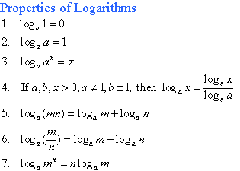
Properties of Logarithmic Functions

Slide 9
Important Logarithmic Functions
pH = - log [H+]

