Slide 1
Subtracting Rational Expressions

Slide 2
Step 1 Common Denominator
You need to find the least common denominator.
(If the rational expressions already have a common denominator then subtract the numerators across the top.)
The common denominator is x(x-6)(x+6)

Slide 3
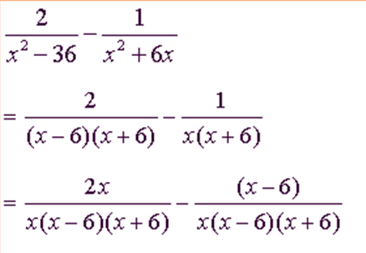
Step 2 Top and bottom
You need to multiply the numerator by the same number you multiplied the denominator with.

Slide 4
Step 3 Subtract Numerators

Slide 5
Step 4 simplify

