Slide 1
Multiplying Rational Expressions

Slide 2
Multiply when P, Q, R, and S are polynomials with Q≠0 and S≠0.
P R PR
Q S QS

Slide 3
1) Multiply the numerators and the denominators 2) Factor the numerators and denominators 3) Simplify

Slide 4
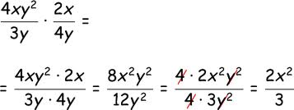
Example:
$\frac{1x}{2x}$×$\frac{{3x}^{2}}{{9x}^{3}}$=$\frac{{3x}^{3}}{{18x}^{4}}$

