Slide 1
Systems of Equations
Algebra 1: Unit 7

Slide 2
Review Answers
Solve systems section:
(-1, 3) (1,2)
(-1, -1) (6.5, -1)
(-4, -1) (2, 3)
(1/3, 10) (4, 3)

Slide 3
Review Answers
Word Problems section:
$23 per bush, $47 per tree
1500 children, 700 adults attended
Sell 33.4 toothpicks and $100.33 to produce
Sell 552.88 pounds of tomatoes and $884.60 to produce

Slide 4
Standards:
Test Standards:
Standard 59: Graph a system of linear equations in a coordinate plane.
Standard 60: Graph a system of linear inequalities in a coordinate plane.
Standard 61: Determine the intersection point of a system of equations and denote its importance.
Standard 62: Graph a system of linear equations in a coordinate plane in a real-world application.
Standard 63: Use a graph of a system of linear inequalities to solve a real-world application.
Standard 64: Solve a system of linear equations using substitution method.
Standard 65: Solve a system of linear equations using the elimination method.
Standard 66: Solve real-life application questions using the substitution and elimination methods.

Slide 5
Standard 59: Graph a system of linear equations in a coordinate plane.
Graph the system of equations on a coordinate plane:
Y = -1/2x – 1
Y = 1/4x – 4

Slide 6
Standard 60: Graph a system of linear inequalities in a coordinate plane.
Graph the system of inequalities in the coordinate plane.
Y ≥ 2/3x + 3
Y > -4/3x - 3

Slide 7
Standard 61: Determine the intersection point of a system of equations and denote its importance.
Determine the intersection point of the two given lines and denote its importance.
Y = -1/2x – 2
Y = -3/2x + 2

Slide 8
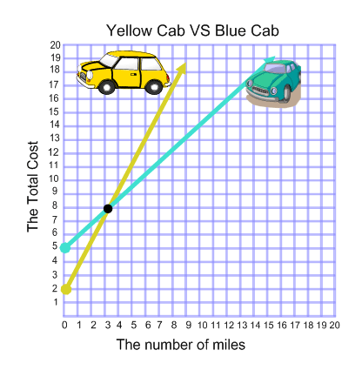
Standard 63: Use a graph of a system of linear inequalities to solve a real-world application.
Given the graph to the right, what is the importance of the intersection point?

Slide 9
Standard 64: Solve a system of linear equations using substitution method.
Solve the system using the substitution method.
Y = x – 1
2x – 3y = -1

Slide 10
Standard 65: Solve a system of linear equations using the elimination method.
Solve the system of equations using elimination method.
-7x – 2y = -13
X – 2y = 11

Slide 11
Standard 66: Solve real-life application questions using the substitution and elimination methods.
Solve the given application problem for the break-even point.
I am starting a business of selling poptarts. Each package costs $.75 to produce with a fixed cost of $400. How many poptarts should I sell to break even if I am selling them for $1.50 each?

Slide 12
Solve
Solve with whichever method you see fit:
Y = -5x – 17
Y = -x - 1

Slide 13
Solve
Solve with whichever method you see fit:
-5x + y = -3
3x – 8y = 24

Slide 14
Solve
Solve with whichever method you see fit:
Y = 6x – 11
-2x – 3y = -7

Slide 15
Solve
Solve with whichever method you see fit:
At a public carnival, children are charged $2.00 for admission and adults are charged $5.00 for admission. On a specific day, there were 417 people and the carnival received $1,449 in admission. How many children and how many adults attended the carnival?

Slide 16
Questions?

