Slide 1
Algebra 2: Unit 4 Review
(complex and imaginary numbers)

Slide 2
Question 1:
Factor the given polynomial completely:
$x^{3}−{7x}^{2}+7x+15$
(x + 1)(x - 3)(x - 5)

Slide 3
Question 2:
Factor the given polynomial completely:
${4x}^{4}−{12x}^{3}−{23x}^{2}+30x −8$
(2x – 1)(2x – 1)(x – 4)(x + 2)

Slide 4
Question 3:
Factor the given polynomial completely:
$x^{4}+x^{3}−{33x}^{2}+9x −378$
(x – 3i)(x + 3i)(x – 6)(x + 7)

Slide 5
Question 4:
Multiply:
$\left(x −4i\right)\left(x+4i\right)$
x² + 16
Multiply!

Slide 6
Question 5:
What is the mathematical name for the pair below?
$(x −4i)(x+4i)$
Conjugate Pair!

Slide 7
Question 6:
Multiply:
$\left(x+i\right)\left(x−i\right)\left(x −2\right)\left(x+3\right)$
$x^{4}+x^{3}−{5x}^{2}+x −6$

Slide 8
Question 7:
Given the zero's below, write the equation in factored form:
5i, -5, 2
(x – 5i)(x + 5i)(x + 5)(x – 2)

Slide 9
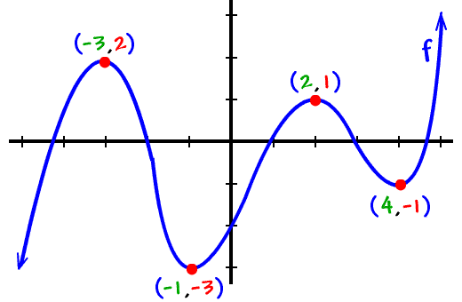
Question 8:
Given the graph of the polynomial function, tell:
Increasing and decreasing,
Relative max or min
Absolute max or min
Inflection points

Slide 10
Question 9:
Determine the voltage of a circuit that has an impedance of 4 – 7i ohms and a current of 6 + 5i amps.
V = I*Z
59 – 22i

Slide 11
Question 10:
Any questions?

